Slide 1


Python Programming
RGM College of Engineering & Technology (Autonomous)
Department of Computer Science & Engineering
Academic Year : 2020-2021

Slide 2
Python Language Fundamentals - 5

Slide 3

Guido Van Rossum

Slide 4
Learning Mantra
If you really strong in the basics, then remaining things will become so easy.

Slide 5
Agenda:
1. Data types in Python – ‘int’ data type
2. Data types: Base conversion functions
3. Data types: float data type

Slide 6
Data types in Python – ‘int’ data type
1. Integer type
We can use 'int' data type to represent whole numbers (integral values)
Suppose we want to represent the following number, 1234567888897333. Is it Integral number or not? Yes, it is not taking any fractional part, so it is an integer number.
This number is too long number. To represent too long numbers, we have long data type is there. To represent small integer numbers, we have int data type is there.
Note:
In Python2 we have long data type to represent very large integral values. But in Python3 there is no long type explicitly and we can represent long values also by using int type only.

Slide 7
Data types in Python – ‘int’ data type
Representations of integral values in Python:
We can represent integral values in the following ways:
1. Decimal form (base 10)
2. Binary form (base 2)
3. Octal form (base 8)
4. Hexa decimal form (base 16)
1. Decimal form(base-10):
It is the default number system in Python.
The allowed digits are: 0 to 9
Eg: a =10

Slide 8
Data types in Python – ‘int’ data type
2. Binary form(base-2):
The allowed digits are : 0 & 1
Literal value should be prefixed with 0b or 0B
Eg:
a = 0B1111
a = 0B123 ➔ SyntaxError: invalid digit '2' in binary literal
a = 0b111

Slide 9
Data types in Python – ‘int’ data type
3. Octal Form(base-8):
The allowed digits are : 0 to 7
Literal value should be prefixed with 0o or 0O.
4. Hexa Decimal Form(base-16):
The allowed digits are : 0 to 9, a-f (both lower and upper cases are allowed)
Literal value should be prefixed with 0x or 0X
Note:
Being a programmer we can specify literal values in decimal, binary, octal and hexa decimal forms. But PVM will always provide values only in decimal form.

Slide 10
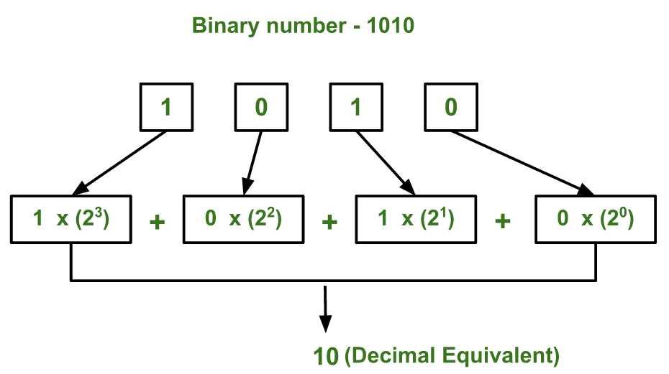
Conversion from Binary to decimal

Slide 11
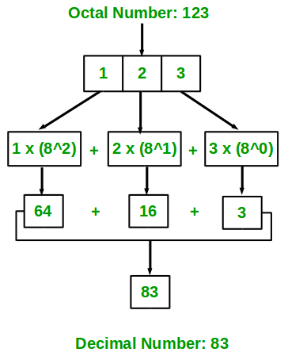
Conversion from Octal to decimal

Slide 12
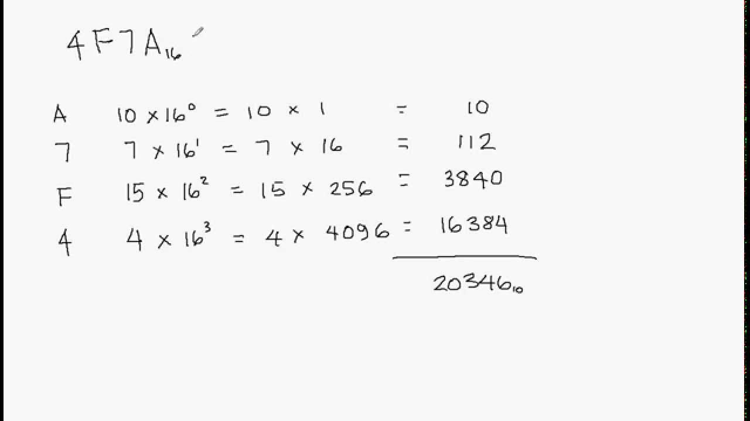
Conversion from Hexadecimal to decimal

Slide 13
Test Your Skills
1. a = 0b1111
print(a) ➔
2. a = b111
print(a) ➔
3. a = 0o123
print(a) ➔
4. a = 0o786
print(a) ➔

Slide 14
Test Your Skills
5. a = 0x10
print(a) ➔
6. a = 0Xface
print(a) ➔
7. a = 0xbeer
print(a) ➔

Slide 15
Data types: Base conversion functions
Now, we will learn about how to convert integral values from one base to another base.
Python provide three in-built functions for base conversions.
1. bin():
We can use bin() to convert from any other base to binary.
2. oct()
We can use oct() to convert from any other base to octal.
3. hex()
We can use hex() to convert from any other base to hexadecimal
Note :
All these base conversion functions are applicable only for Integral numbers.

Slide 16
Test Your Skills
1. bin(15) ➔
2. bin(0o123) ➔
3. bin(0xface) ➔
4. oct(0b111101) ➔
5. oct(0xface) ➔
6. oct(100) ➔
7. hex(1000) ➔
8.hex(0b10111111) ➔
9. hex(0o123456) ➔

Slide 17
Data types: float data type
We can use float data type to represent floating point values (Number with decimal values).
We can represent integral values in decimal, binary, octal and hexadecimal forms. But we can represent float values only by using decimal form.
We can also represent floating point values by using exponential form (scientific notation)
f = 1.2e3
print(f) ➔1200.0
instead of 'e' we can use 'E'

Slide 18
Data types: float data type
The main advantage of exponential form is we can represent big values in less memory.
Assume that we need to store a value (12000000000000000.0)
f=1.2e16
print(f) ➔1.2e+16
Even in our calculators also to represent bigger values, we need to go for exponential notation.

Slide 19
Data types: float data type
Eg:
f = 1.234 ➔ Valid
f = 0b1.234 ➔ Invalid
f = 0o1.234 ➔ Invalid
f = 0x1.234 ➔ Invalid

Slide 20

Any question?

Slide 21
If you try to practice programs yourself, then you will
learn many things automatically
Spend few minutes and then enjoy the study

Slide 22
Thank You

